Slide 1
Data Preprocessing & Visualization
Session 1: (Numpy)

Slide 2
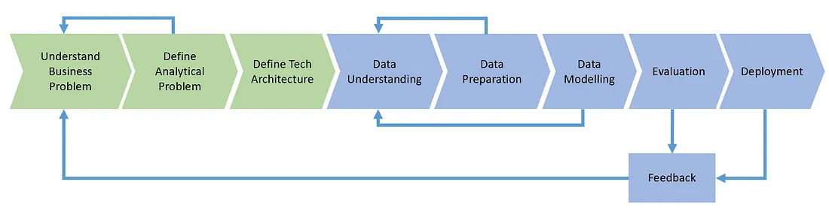

Slide 3

ملفات csv (ML )
صور او فيديوهات (DL,CV)
نصوص او صوت (DL,NLP)

Slide 4
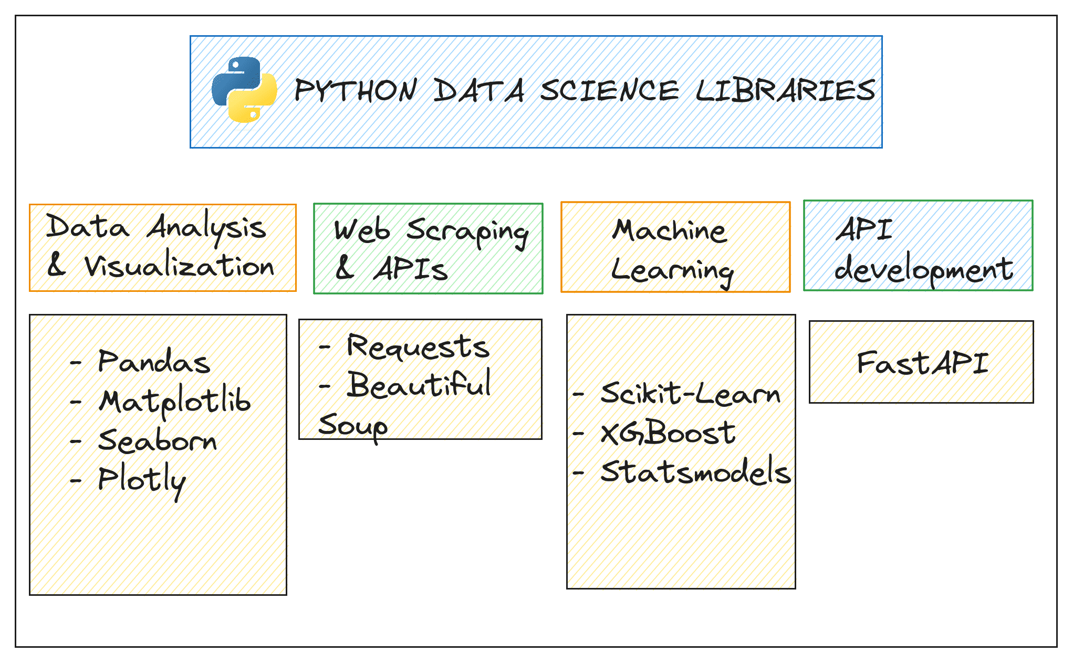

Slide 5
Agenda:
1 | Introduction to Numpy
2 | Numpy Arrays
3 | Practical Applications

Slide 6
Introduction to Numpy

Slide 7
Introduction to Numpy
What is Numpy?
Numpy is a fundamental package for scientific computing in Python. It is used for performing numerical operations on large, multi-dimensional arrays and matrices. It also provides a collection of mathematical functions to operate on these arrays.
Numpy is essential for data science, machine learning, and scientific computing because of its efficient array operations and broadcasting capabilities.

Slide 8
Why NumPy?
Speed
Implemented in C and Fortran → much faster than pure Python.
Efficient memory handling.
Handles large datasets easily.
Array Operations
Provides the ndarray object for multi-dimensional arrays.
Supports vectorized operations (no need for loops).
import numpy as np
a = np.array([1,2,3])
b = np.array([4,5,6])
print(a + b) # [5 7 9]

Slide 9
Why NumPy?
built-in Functions
Mathematical: sin, cos, exp, log
Statistical: mean, variance, std
Linear Algebra: dot product, determinant, eigenvalues
Integration
Works with almost every DS/ML library:
Pandas → built on NumPy
Scikit-learn → ML algorithms
TensorFlow / PyTorch → Deep Learning

Slide 10
Numpy Arrays

Slide 11
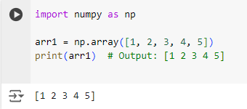
Creating Numpy Arrays
Creating a 1D Numpy Array from a List
This creates a one-dimensional Numpy array arr1 from a Python list. Numpy arrays are more efficient for numerical operations than Python lists.

Slide 12
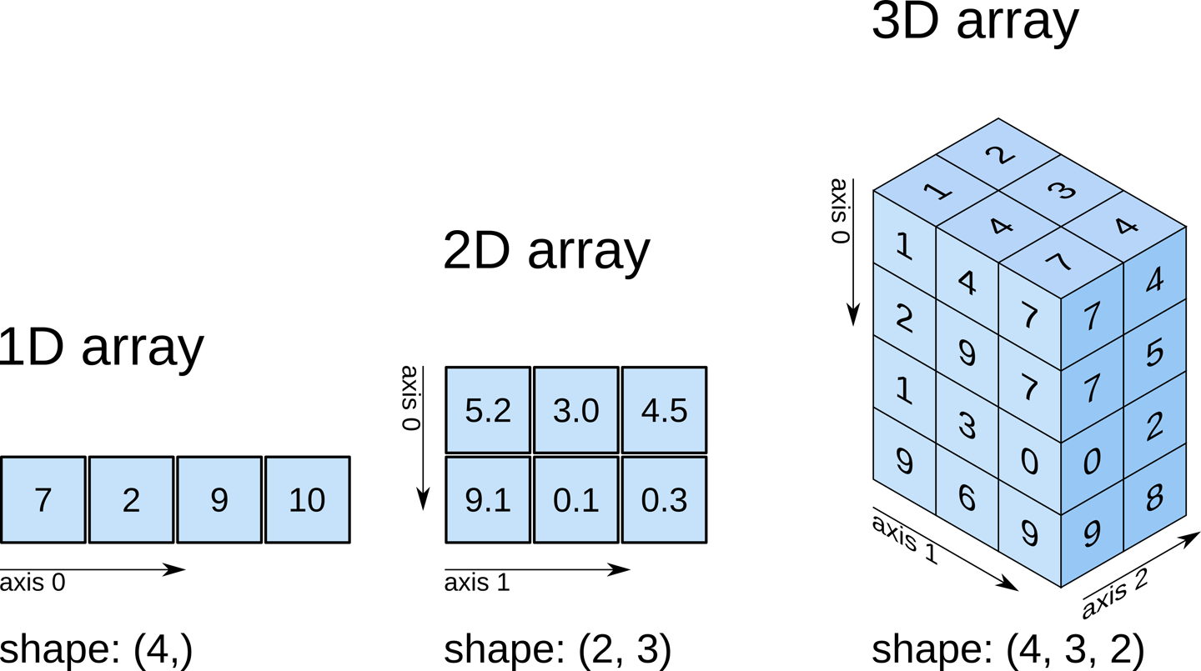
Shape of NumPy Arrays
The shape of a NumPy array is represented as a tuple, indicating the number of elements present in each dimension. It provides information about the size of the array across its various dimensions.

Slide 13
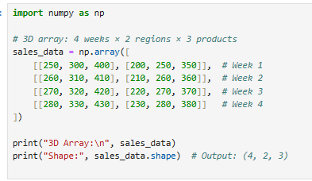
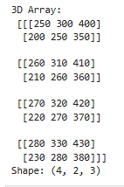
N-dimensional arrays:
Suppose you want to store sales data for three products over four weeks across two regions. This can be represented as a 3D array where:
Axis 0: Weeks (4 weeks).
Axis 1: Regions (2 regions).
Axis 2: Products (3 products).
Using NumPy, you can create this 3D array as follows:

Slide 14
Where Data Scientists Use nD Arrays?
Direct Use (Explicit):
To represent multi-dimensional data (e.g., Time × Region × Product).
For slicing/aggregation across dimensions.
When preparing custom features before modeling.
Indirect Use (Implicit / Built-in):
Most ML/DL libraries (TensorFlow, PyTorch, scikit-learn) already handle 3D arrays internally.
Examples:
Computer Vision: Images = (Height × Width × Channels) (256, 256, 3).
NLP: Text embeddings = (Batch × Sequence × Embedding).
Time Series: Input shape = (Samples × Timesteps × Features).
👉 In short: You rarely build 3D arrays from scratch daily, but you must understand them, since models rely on them under the hood.

Slide 15
Do modern models reshape data automatically, or do you need to do it?
Models don’t reshape data for you: Neural networks expect input with a specific structure—if your data doesn’t match that exact shape, you'll get an error
You’re responsible for reshaping: As a Data Scientist, it’s your job to adjust your data (using functions like reshape, resize, etc.) to exactly match the model’s expected input format.
No automatic shape correction: Most models won’t rearrange your data—except for minimal cases (like adding a batch dimension)—so you must ensure it’s formatted correctly

Slide 16
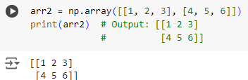
Creating Numpy Arrays
Creating a 2D Numpy Array from a List of Lists
This creates a two-dimensional Numpy array arr2 from a list of lists. Numpy arrays can handle multi-dimensional data easily.

Slide 17
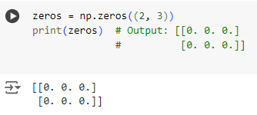
Creating Numpy Arrays
Creating an Array of Zeros
This creates a 2x3 Numpy array filled with zeros. It is useful for initializing arrays with default values.

Slide 18
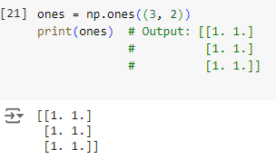
Creating Numpy Arrays
Creating an Array of Ones
This creates a 3x2 Numpy array filled with ones. It’s useful for creating arrays where all elements start with a value of one.

Slide 19
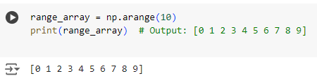
Creating Numpy Arrays
Creating an Array with a Specific Range
This creates a one-dimensional array of integers from 0 to 9 using np.arange(). It’s similar to Python’s built-in range() but returns a Numpy array.

Slide 20
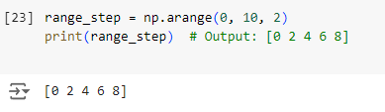
Creating Numpy Arrays
Creating an Array with a Range of Values and Specific Step Size
This creates an array with values starting from 0 up to (but not including) 10, with a step size of 2. Useful for generating sequences with a specific interval.

Slide 21
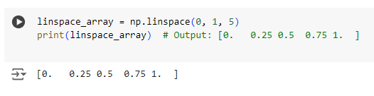
Creating Numpy Arrays
Creating an Array of Evenly Spaced Values Between Two Numbers
This creates an array of 5 evenly spaced values between 0 and 1. np.linspace() is often used for generating a sequence of numbers over a specified interval.

Slide 22
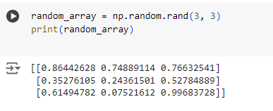
Creating Numpy Arrays
Creating an Array with Random Values Between 0 and 1
This creates a 3x3 array with random floating-point numbers between 0 and 1. Useful for simulations and generating random datasets.

Slide 23
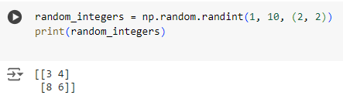
Creating Numpy Arrays
Creating an Array with Random Integers
This creates a 2x2 array with random integers between 1 and 9. Ideal for testing and generating sample data.

Slide 24
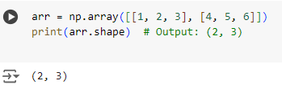
Creating Numpy Arrays
Checking the Shape of an Array
This returns the shape of the array, showing it has 2 rows and 3 columns. shape is useful for understanding the structure of multi-dimensional arrays.

Slide 25

Creating Numpy Arrays
Accessing Data Type of Elements
This checks the data type of elements in the array, showing that they are 64-bit integers. Knowing the data type helps optimize storage and computation.

Slide 26
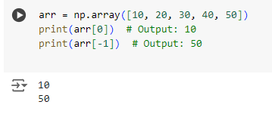
Creating Numpy Arrays
Indexing a 1D Array
This accesses elements in the array by their index. Positive indices start from the beginning, while negative indices start from the end.

Slide 27

Creating Numpy Arrays
Slicing a 1D Array
This slices the array to get a subarray from index 1 to 3. Slicing is useful for extracting parts of an array.

Slide 28
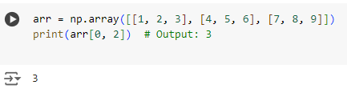
Creating Numpy Arrays
Indexing a 2D Array
This accesses the element in the first row and third column of the array. 2D indexing requires specifying both row and column indices.

Slide 29
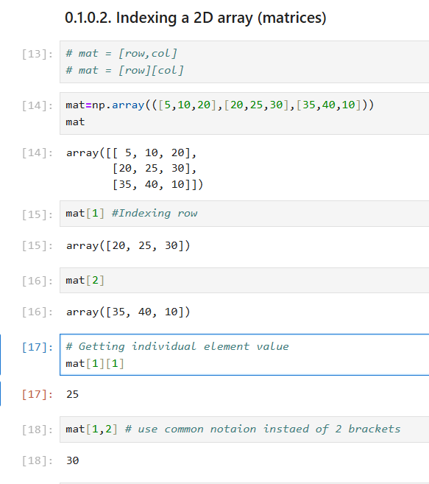

Slide 30
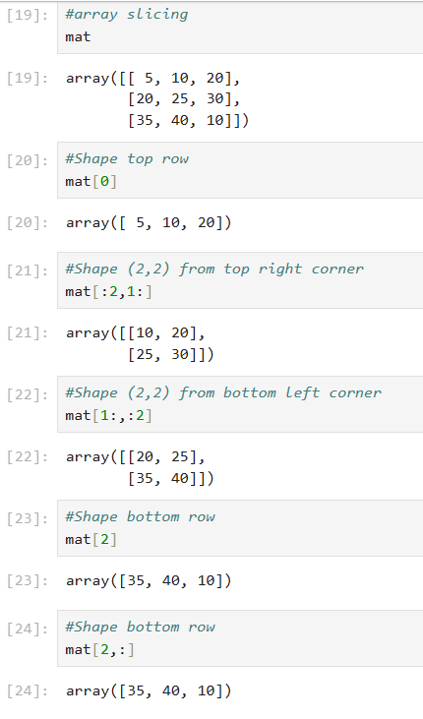
Creating Numpy Arrays
Slicing a 2D Array

Slide 31
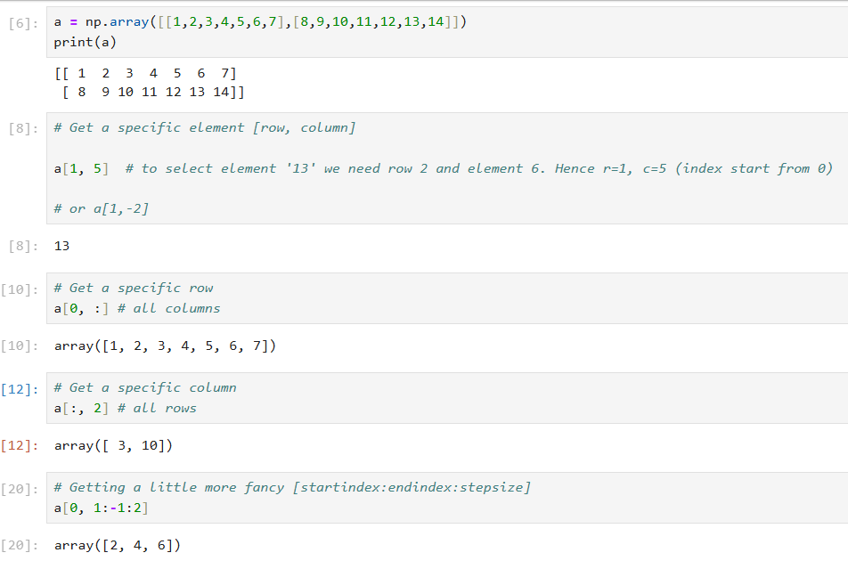

Slide 32
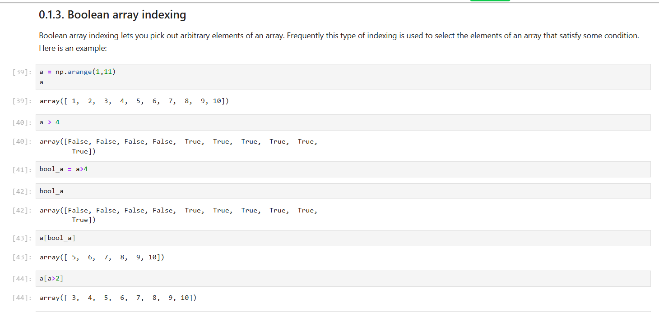

Slide 33
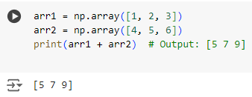
Creating Numpy Arrays
Element-wise Addition
This performs element-wise addition of two arrays. Numpy automatically adds corresponding elements, making operations concise and efficient.

Slide 34
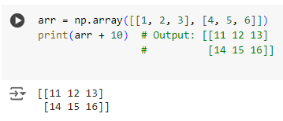
Creating Numpy Arrays
Array Broadcasting
Broadcasting allows arithmetic operations on arrays of different shapes. Here, 10 is added to each element of the array.
If a mathematical operation fails due to shape incompatibility or when broadcasting rules don't apply, Numpy will raise an error. This happens because Numpy can't carry out the operation as there is an unresolved dimensional mismatch.

Slide 35
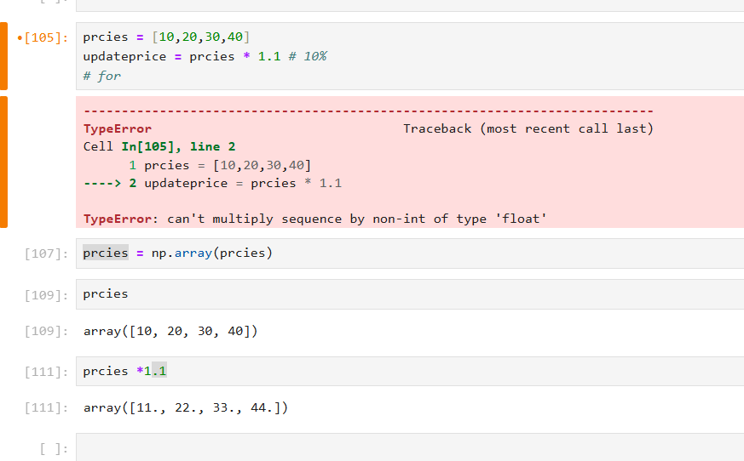
Array Broadcasting

Slide 36
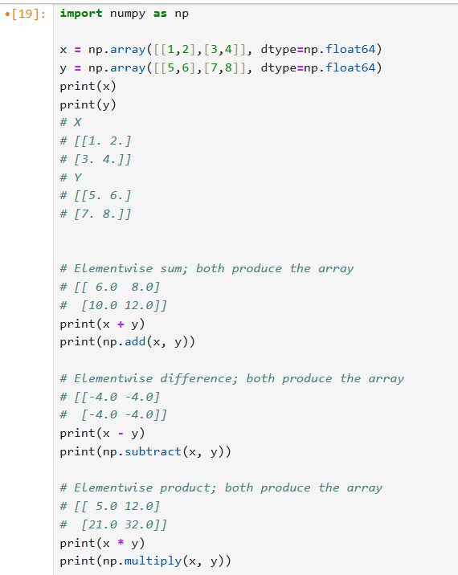
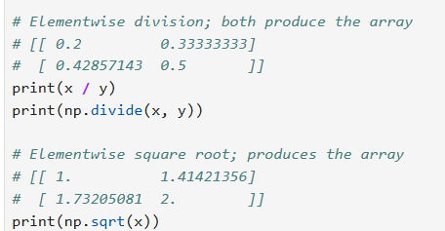
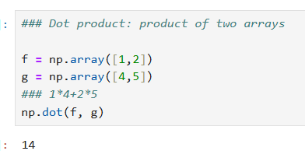
0.1.1. Universal Array Functions (Mathematical operations)

Slide 37
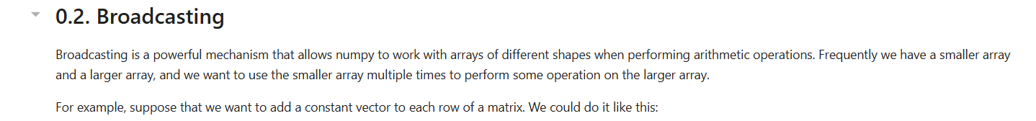
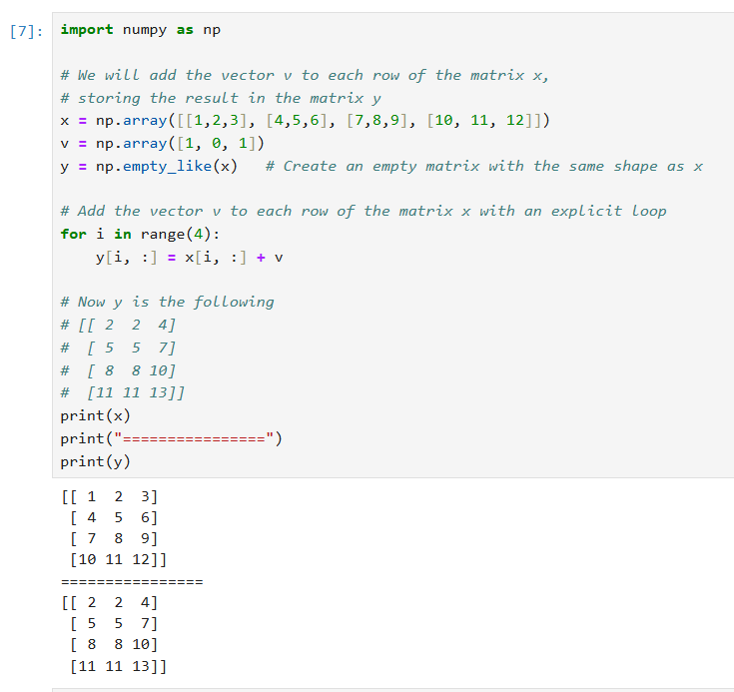

Slide 38
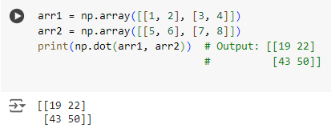
Creating Numpy Arrays
Matrix Multiplication
This performs matrix multiplication using np.dot(), which calculates the dot product of two arrays. Useful for linear algebra applications.

Slide 39
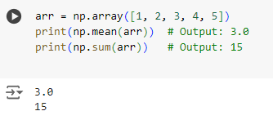
Creating Numpy Arrays
Calculating Mean and Sum
These operations calculate the mean (average) and sum of the array elements. Numpy provides efficient built-in functions for statistical calculations.

Slide 40
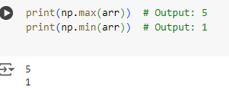
Creating Numpy Arrays
Finding Maximum and Minimum Values
np.max() finds the maximum value, and np.min() finds the minimum value in the array. Useful for identifying the range of data.

Slide 41
Eigenvalues and Eigenvectors.
Now that we’ve seen how NumPy helps us create and manipulate matrices, let’s move one step deeper into Linear Algebra concepts that are very important in Data Science and Machine Learning.
Two of the most fundamental ideas are Eigenvalues and Eigenvectors.
They may sound a bit abstract at first, but they are actually everywhere in Data Science.
From PCA for dimensionality reduction, to understanding covariance in datasets, to optimizing machine learning models – these concepts play a key role.
Think of them as the tools that tell us the main directions of information in our data, and how strong each direction is.

Slide 42
Eigenvalues and Eigenvectors.
1. Eigenvalues & Eigenvectors
Imagine you have a matrix (Matrix) that represents a transformation (like rotation, stretching, or compression).
Eigenvector: a direction (vector) that does not change its direction after the transformation, it may only get stretched or shrunk.
Eigenvalue: the number that tells you how much the eigenvector is stretched or shrunk.
🔹 eigenvector = fixed direction, eigenvalue = scaling factor.

Slide 43
2. Eigenvalues & Covariance Matrix
The Covariance Matrix describes how features (variables) are correlated with each other.
If we perform Eigen Decomposition on it:
Eigenvectors = the directions that explain the largest amount of variance in the data.
Eigenvalues = how much variance is explained along each direction.
This is exactly what happens in PCA (Principal Component Analysis):
Sort eigenvalues from largest to smallest.
Keep the top eigenvectors → reduce dimensions while preserving most of the variance.

Slide 44
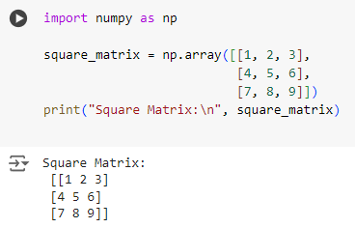
Square Matrix
A matrix with the same number of rows and columns.
Practical Uses
Covariance Matrix → always square.
Adjacency Matrix (Social Networks / Graphs).
Image Filters (3×3, 5×5 kernels in Computer Vision).
This is a 3x3 matrix where the number of rows equals the number of columns.

Slide 45
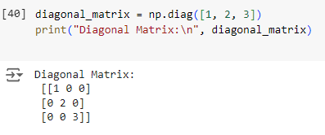
Diagonal Matrix
A matrix in which all off-diagonal elements are zero
Practical Uses
Covariance matrices sometimes simplified to diagonal (no correlation between features).
Feature scaling and whitening often use diagonal matrices.
Image processing filters can be diagonal for certain effects.
Simplifies many linear algebra operations.
The np.diag() function creates a diagonal matrix where only the elements along the main diagonal are non-zero.

Slide 46
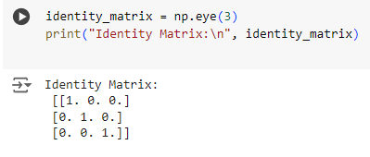
Identity Matrix
A square matrix with ones on the main diagonal and zeros elsewhere.
Practical Uses
Linear Algebra: neutral element in multiplication.
Machine Learning: used in regularization (adding λI to covariance matrix in Ridge Regression).
Computer Vision: identity filter keeps the image unchanged.
Optimization: often appears in matrix factorizations.
A special type of diagonal matrix.
Diagonal elements = 1.
All off-diagonal elements = 0.
The np.eye(3) function creates a 3x3 identity matrix. Identity matrices are used as the multiplicative identity in matrix algebra.

Slide 47
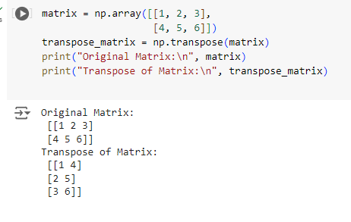
Transpose of a Matrix
Flipping a matrix over its diagonal, switching the row and column indices.
Practical Uses
Dot Product: can be written as
Covariance Matrix: built using transposed data vectors.
Machine Learning: in linear regression
Deep Learning: weight matrices often transposed in backpropagation.
The np.transpose() function is used to find the transpose of a matrix, which switches the rows and columns.
Rows become columns, columns become rows.

Slide 48
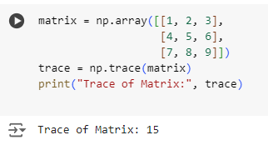
Trace of a Matrix
The sum of all the elements on the main diagonal of a square matrix.
Practical Uses
Machine Learning: cost functions sometimes include trace terms (e.g., matrix norms).
Linear Algebra: trace = sum of eigenvalues of a matrix.
PCA / Dimensionality Reduction: trace of covariance matrix = total variance.
Optimization: used in matrix calculus for gradients.
The np.trace() function calculates the trace of a matrix, which is often used in machine learning algorithms and various mathematical computations.

Slide 49
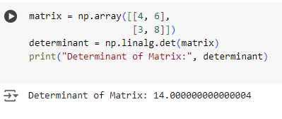
Determinant of a Matrix
A scalar value that is a function of a square matrix, often used in solving linear equations, calculating matrix inverses, and more.
Practical Uses
Unique scalar value calculated from a square matrix.
Tells us whether the matrix is invertible or not.
In Data Science → used in solving linear equations.
The np.linalg.det() function computes the determinant, which provides important information about the matrix properties, such as invertibility.

Slide 50
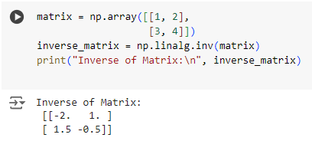
Inverse of a Matrix
A matrix that, when multiplied with the original matrix, yields the identity matrix.
Practical Uses
Works only for square matrices with non-zero determinant.
Like an "undo" operation in mathematics.
Important in regression and optimization problems.
The np.linalg.inv() function finds the inverse of a matrix, which is useful for solving systems of linear equations.

Slide 51
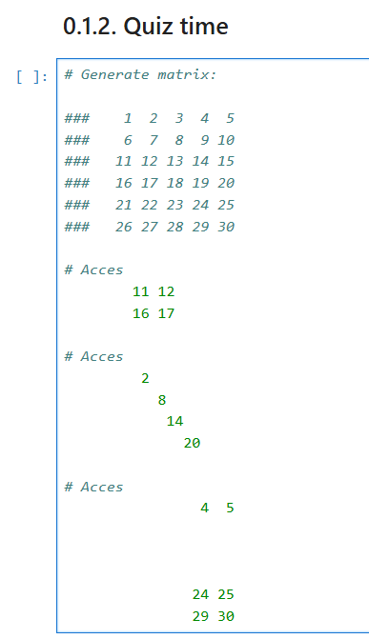
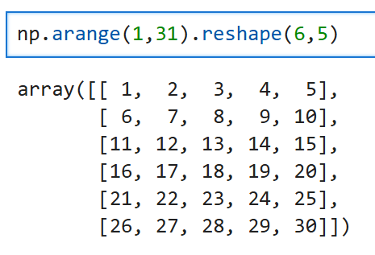

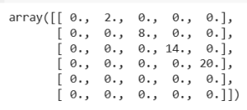
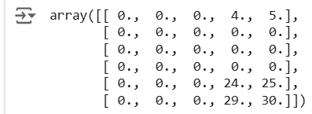
(Numpy) :
Task 1: Slicing

Slide 52
(Numpy) : Task 2: Exercises
Part 1
Create a one-dimensional NumPy array containing numbers from 0 to 9.
Create a 3x3 identity matrix using NumPy.
From a NumPy array containing numbers from 0 to 9, extract all the odd numbers.
Part 2
Convert a one-dimensional NumPy array containing numbers from 1 to 12 into a 3x4 two-dimensional array.
Create a 5x5 array with random values and the values range between 0 and 1.
Create a 5x3 matrix and a 3x2 matrix, then compute their matrix product.
In a one-dimensional array containing numbers from 0 to 10, replace all values between 3 and 8 with their negatives.

